Slide 1
Task 2 on ethical hacking
1
Introduction
Steps
Vedio on steps
Vedio on output
Screenshot
Final report and so on
2
3
4
Presented by: Sagar Shrey
Email: 20bec1061@cuchd.in
Subject: Ethical Hacking
5
6

Slide 2

Welcome to my project Report
Firstly we have to install netsparker in our laptop to find 3 critical vulnerabilities automatically and to see report.
1st Page

Slide 3
Steps to Follow
Task 2: http://zero.webappsecurity.com/
Step 1: Add Website You Want To S To The Dialogue Box.
Step 2: Define The Customization Option To Scan As Per Your Need
Step 3: It Will Start Scanning It Automatically
Step 4: Choose Any One Of The Critical Vulnerabilities.
Step 5: Write Reports For The Vulnerability You Wanted To Write. Make Sure The Report Should Not Be The Same As In Netsparker.
1st Page

Slide 4
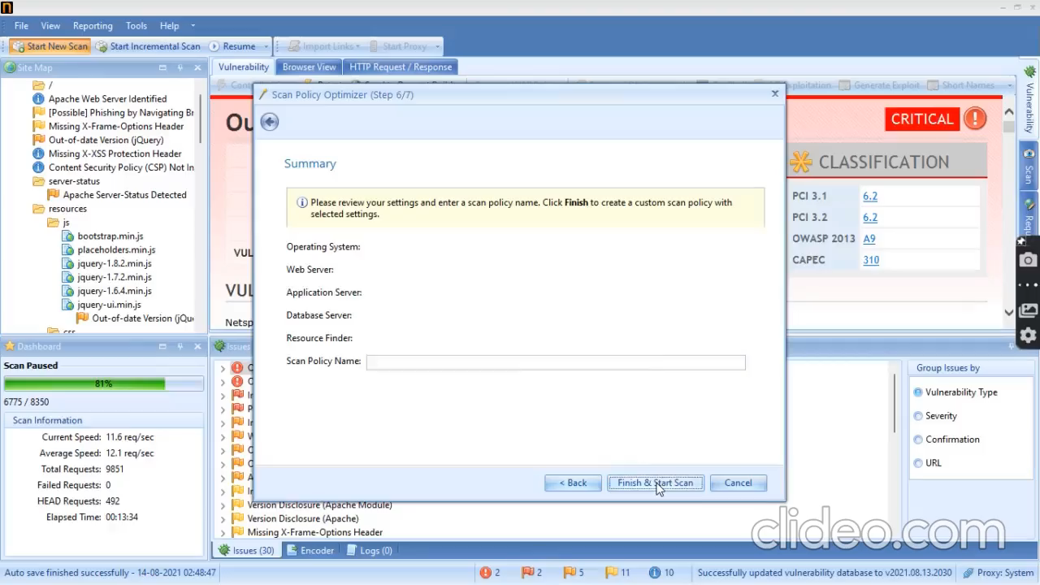
Video on steps of Task
1st Page

Slide 5
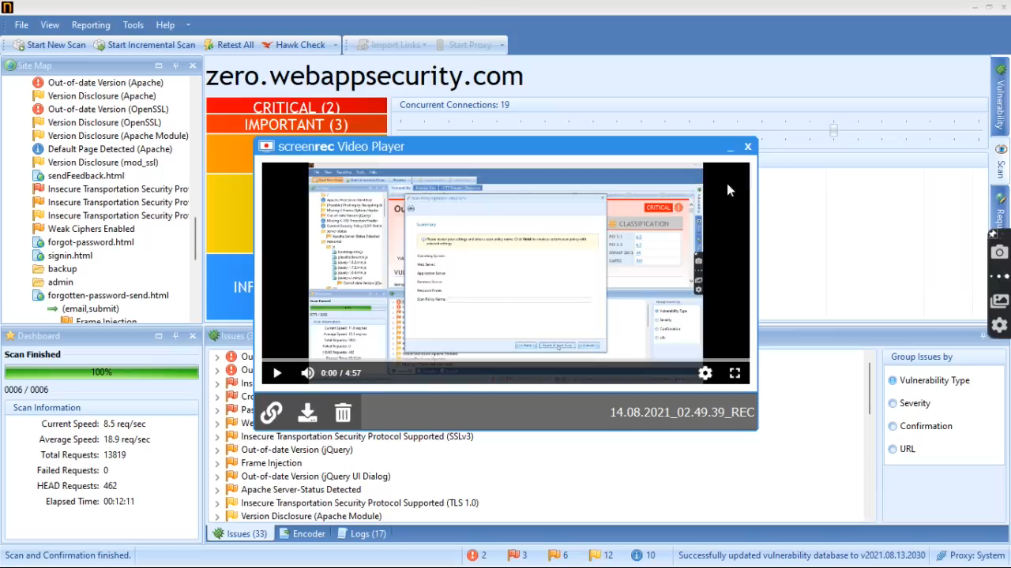
Video on output
1st Page

Slide 6
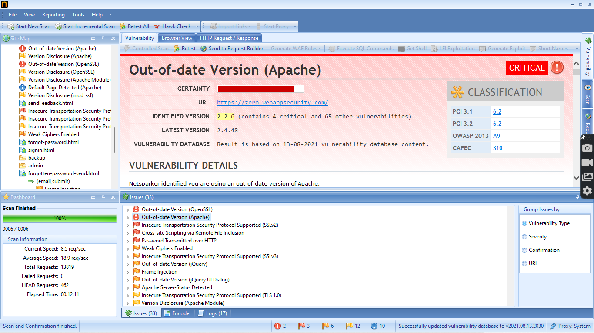
Screenshot of a critical Vulnerability
1st Page

Slide 7
My report in this task
Domain: http://zero.webappsecurity.com/
Windows 11, Netsparker, wifi
Description: This site is using out of version of apache which might be vulnerable for attacks.
Mitigation: If we want to prevent our website we must upgrade apache software to the latest version.
Steps, videos and screenshots are already presented in previous slides.

Slide 8
Acknowledgement
I would like to express my special thanks of gratitude to my teacherwho gave me the golden opportunity to do this wonderful task on the Internship of ethical hacking, which also helped me in doing a lot of research and I came to know about so many new things I am really thankful to him .
1st Page

Slide 9


